Slide 1
Gamification of Data
Group 1: Cameron Kozan, Ryan Ross, Zaid Alsafi, Alex Navarre
Cameron Kozan, Ryan Ross, Zaid Alsafi, Alex Navarre

Slide 2
Introduction
The goal of this project is to develop a gamified web application. The gamified web application will allow for the workers to be more motivated along with increasing productivity. The end goal of this project is for a user to go into the web application see how they rank among their peers, look at achievements, along with how all their teams are doing as well.

Slide 3
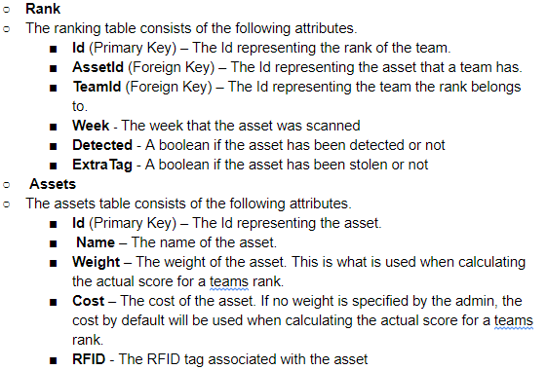
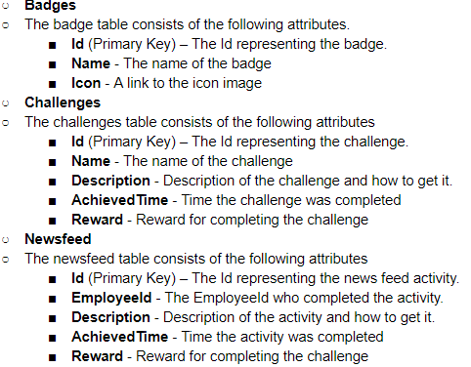
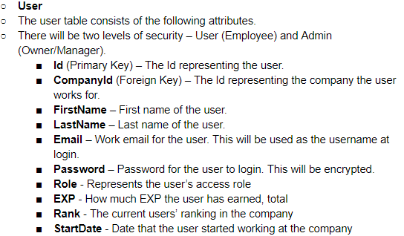
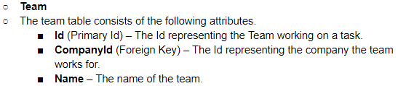
Data Design

Slide 4
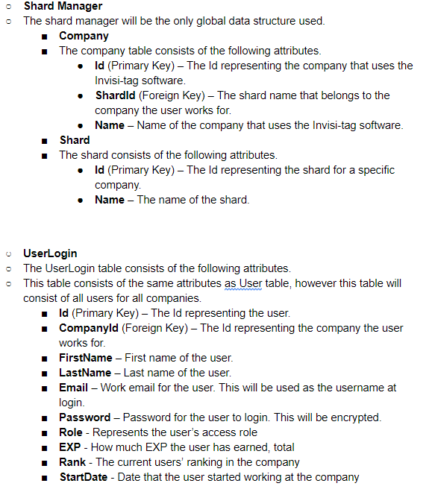
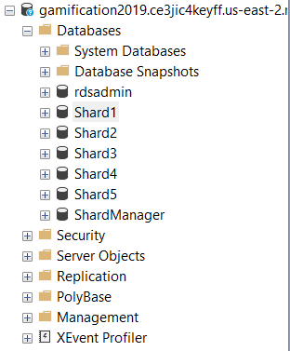
Data Design (cont.)

Slide 5
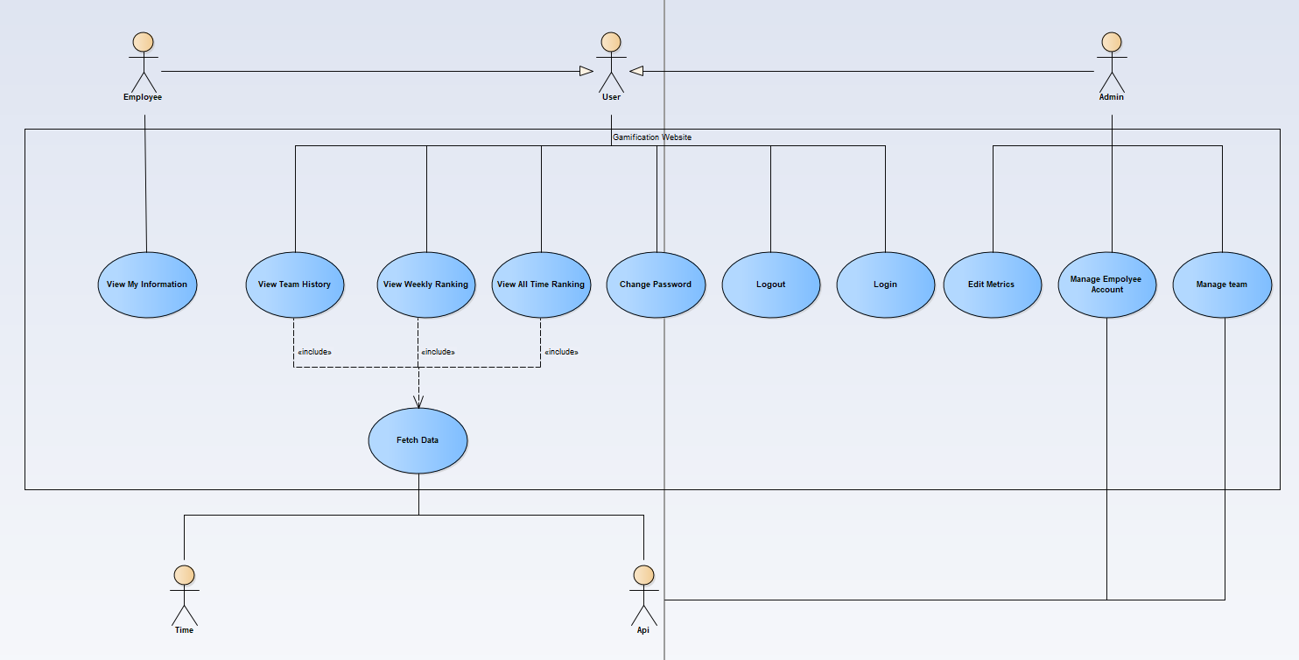
System Use Case

Slide 6
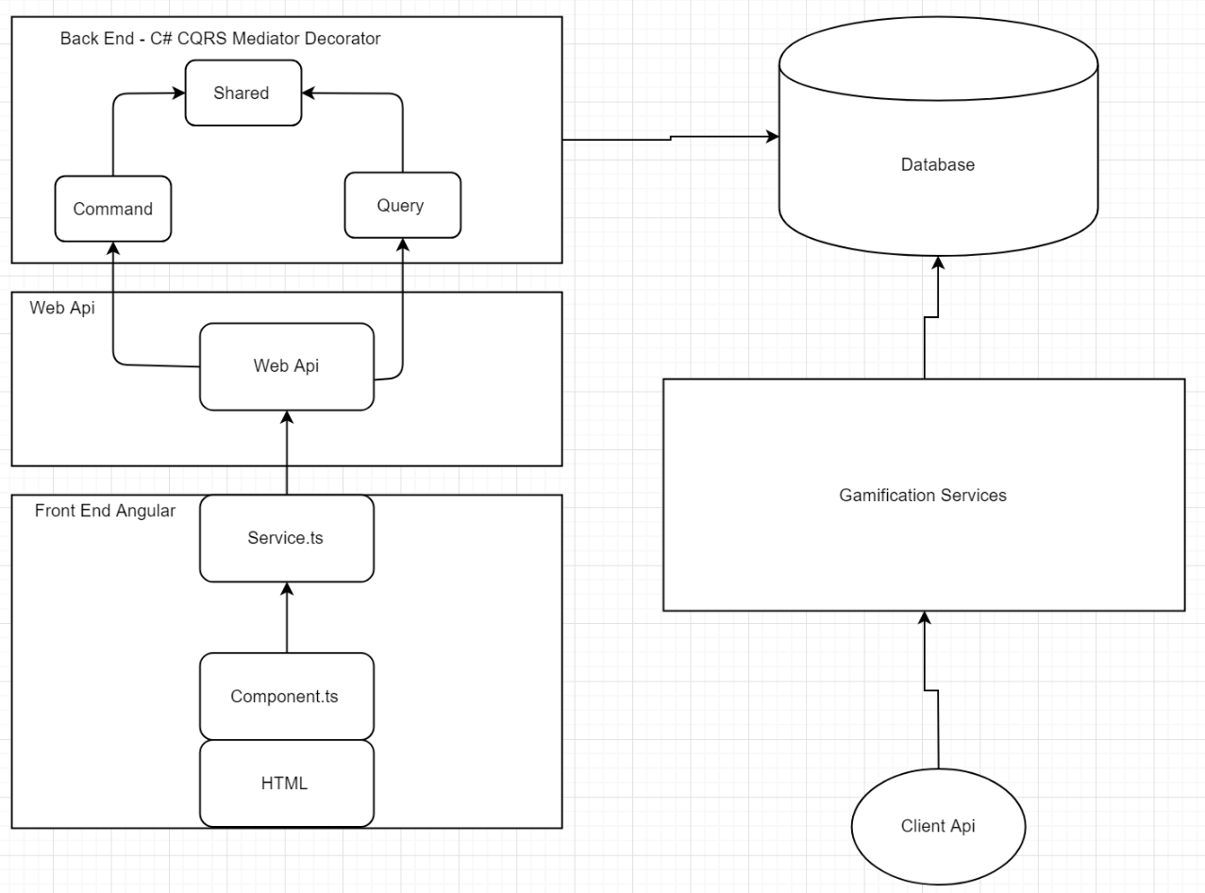
Architecture Diagram - High Level

Slide 7
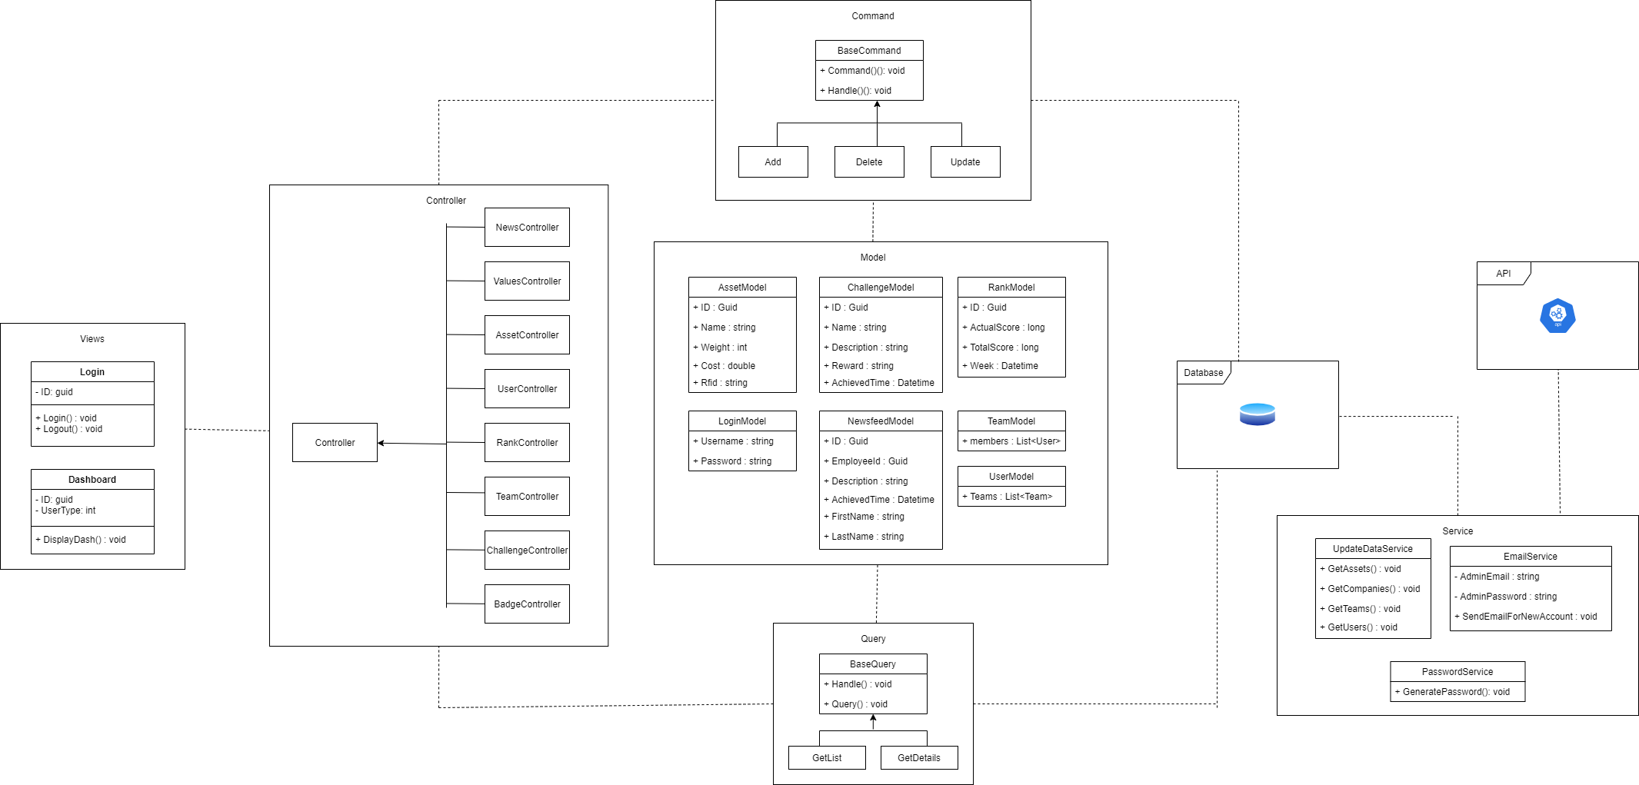
Architecture Diagram

Slide 8
Restrictions, Limitations and Constraints
Restrictions:
The software will need to run on newer web browsers so we are unable to to use specific 3rd party add on features for Angular. This will limit our capabilities when it comes to a more module approach when designing the webpage. We found it most important to keep the webpage running as long as possible in trade off for not using the most current Angular libraries.
Limitations:
A majority of our data comes from the companies already established API. The Invisitag API only allows us to retrieve job start dates and times so we had to manually calculate if a job has been completed. The jobReport/tags (assets used on a job) API calls do not have the tag UUID, instead it has an RFID tag.
Challenges, badges, experience points, and levels are all calculated from an individual's score only. This limits our ability to create extensive and interactive and elaborate challenges. The amount of challenges has been limited due to the small amount of data we have received.

Slide 9

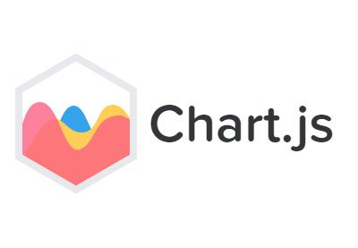



Interface Design
AngluarJS
Chart.js
CanvasJS
Bootstrap
flaticon

Slide 10
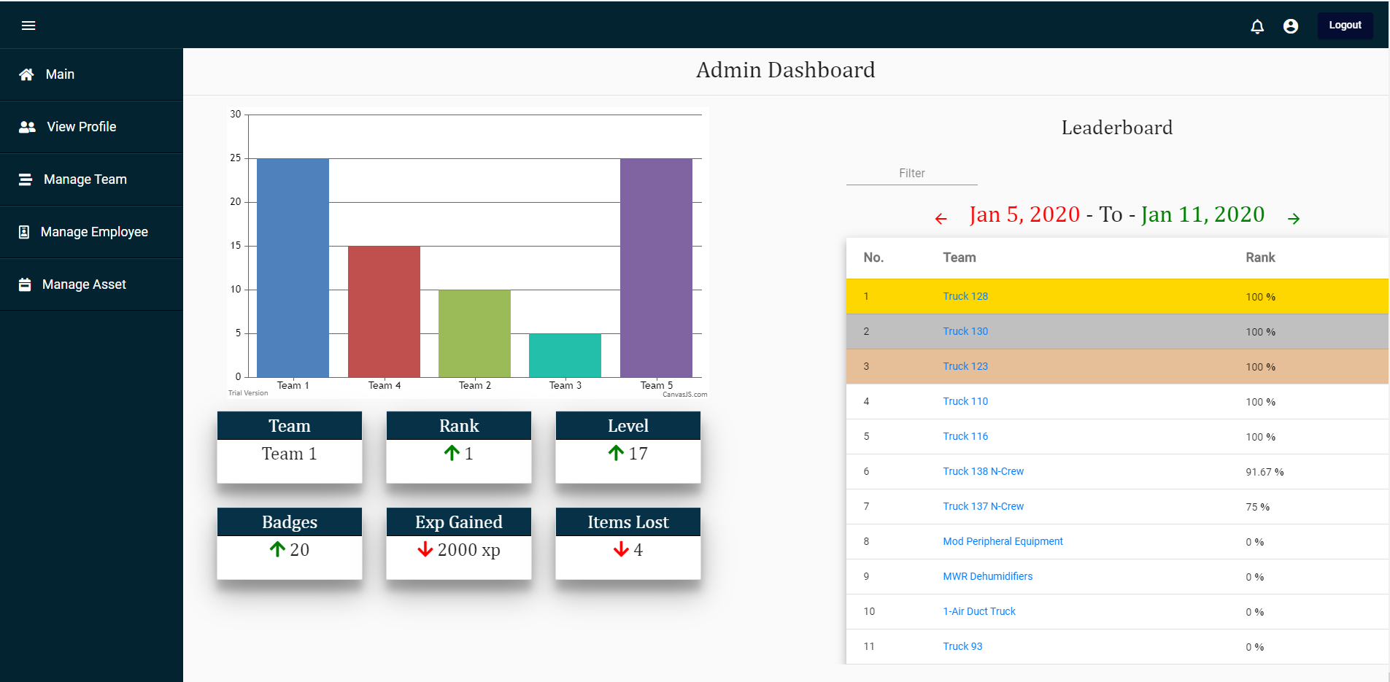
User Interface Design

Slide 11
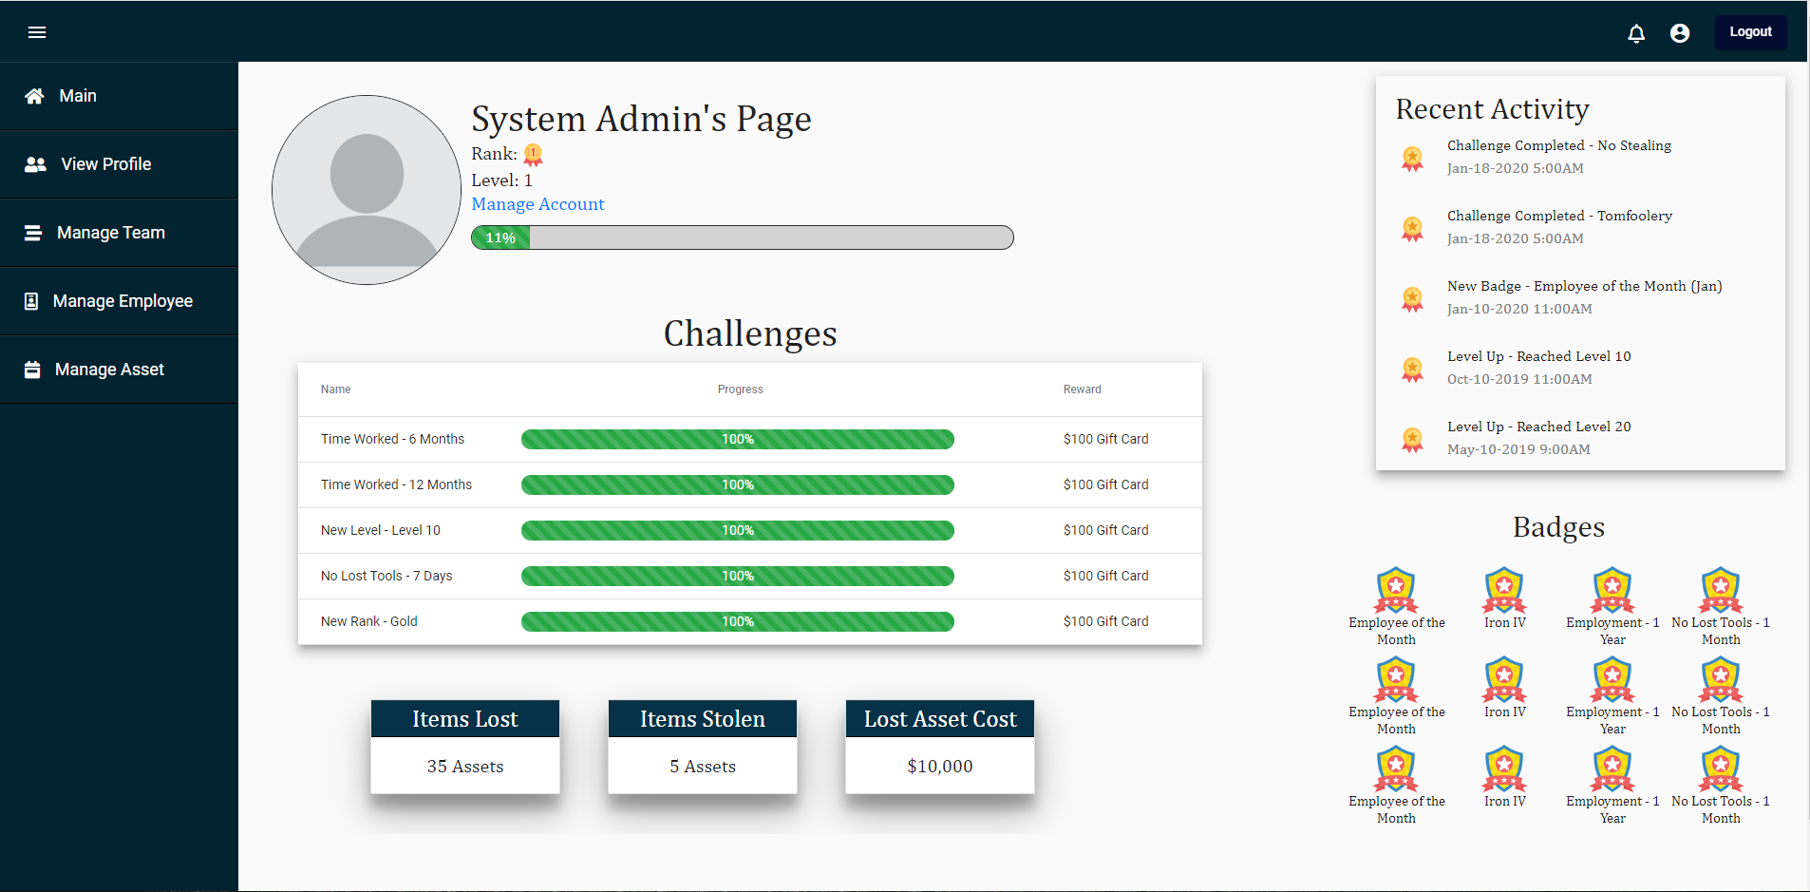
User Interface Design (cont.)

Slide 12
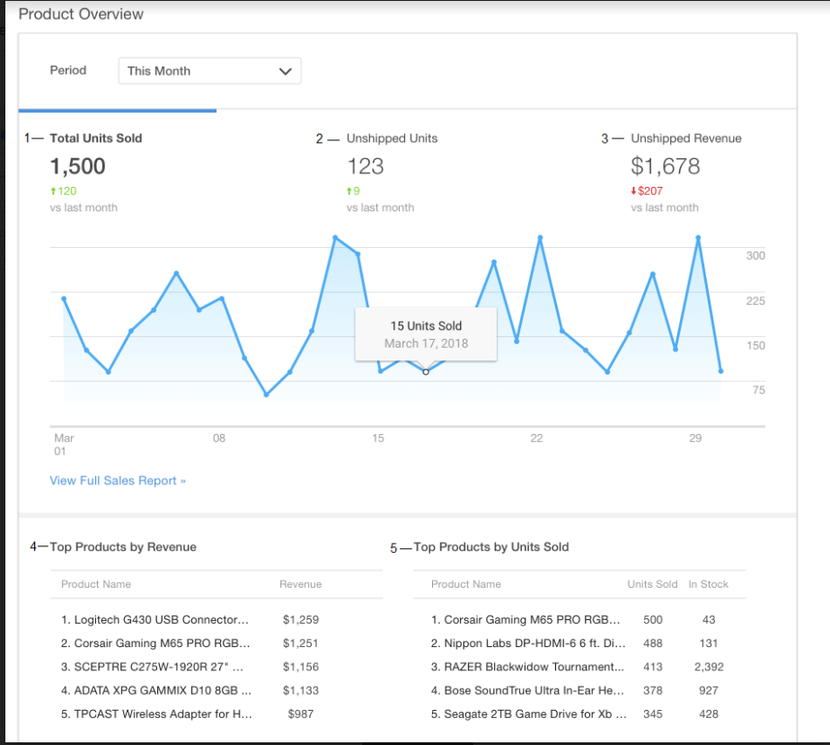
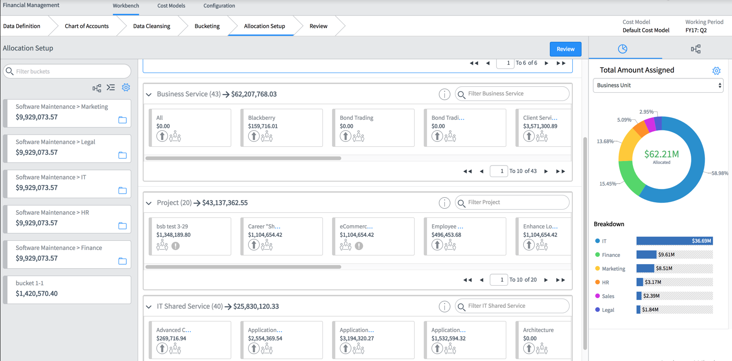
Use of audio visual aid
We used other websites to get a better visual understanding on how a website should flow or main features our website should have.

